Slide 1
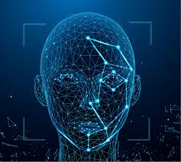
Face Recognition System
Submitted by:
Parastoo Masoodi
&
Naim Rahman Ifti

Slide 2
What is Face Recognition?
A biometric technology that identifies or verifies individuals by analyzing their facial features. It involves comparing a detected face to known faces in a database.

Slide 3
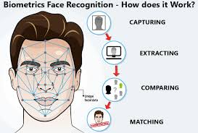
Facial recognition generally involves two stages: -Face Detection: where a photo is searched to find a face, then the image of Mobile, is processed to crop and extract the person’s face for easier recognition. -Face Recognition: where that detected and processed face is compared to a database of known faces, to decide who that person is.

Slide 4
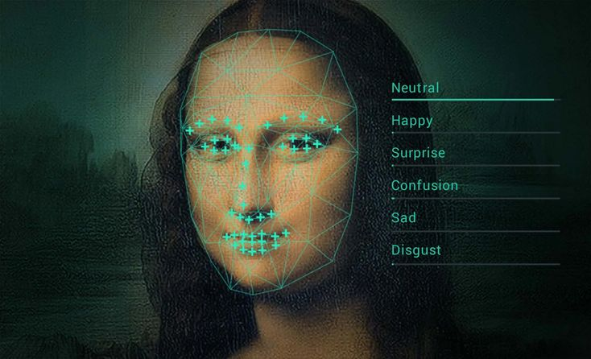
Importance:
Face recognition has become a widely used tool in security and personal tech due to its non-invasiveness and uniqueness – “faces” are a key identifier just like fingerprints or iris patterns. It’s used in everything from unlocking smartphones to identifying suspects.

Slide 5
Applications of Face Recognition
Surveillance and Security
Mobile Phone Unlock & Personal Device Security
Social Media and Photography
Healthcare
Retail and Marketing
Automotive
Education and Attendance
Entertainment and Other Uses

Slide 6
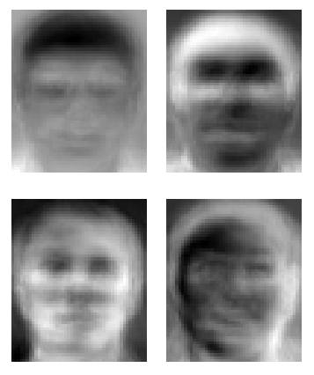
Challenges in Face Recognition
Lighting and Environmental Factors.
Poses!
Facial Expressions.
Image Quality
Aging
…

Slide 7

What Is OpenCV?
Open-source Computer Vision Library
Offers tools for face detection and face recognition
Widely used in academic projects and industry apps

Slide 8

Why Use OpenCV?
Easy to implement classical methods
Lightweight and suitable for small datasets
Great for learning the fundamentals of face recognition

Slide 9
Face Detection and Recognition
Face Detection:
Uses OpenCV’s Haar Cascade Classifier (haarcascade_frontalface_default.xml) to detect faces in images or live camera feed.
Face Recognition:
Trains an LBPH Face Recognizer using collected face images from dataset/.
Saved the trained model to trainer.yml.
Recognizes faces from live webcam using the trained model.

Slide 10

Face Detection with Haar Cascade
Haar Cascade is a machine learning-based approach.
Used to detect faces efficiently in real-time.

Slide 11
Face Recognition with LBPH
LBPH (Local Binary Patterns Histogram) is a simple and fast algorithm.
Suitable for real-time face recognition, especially for small datasets.
Training:
Collect images.
Extract faces.
Train LBPH recognizer.
Recognition:
Predict the face ID and confidence from new images.

Slide 12

Dataset Collection
Collect multiple face images per user.
Save them into dataset/ folder.
Each image labeled with the user's ID.

Slide 13
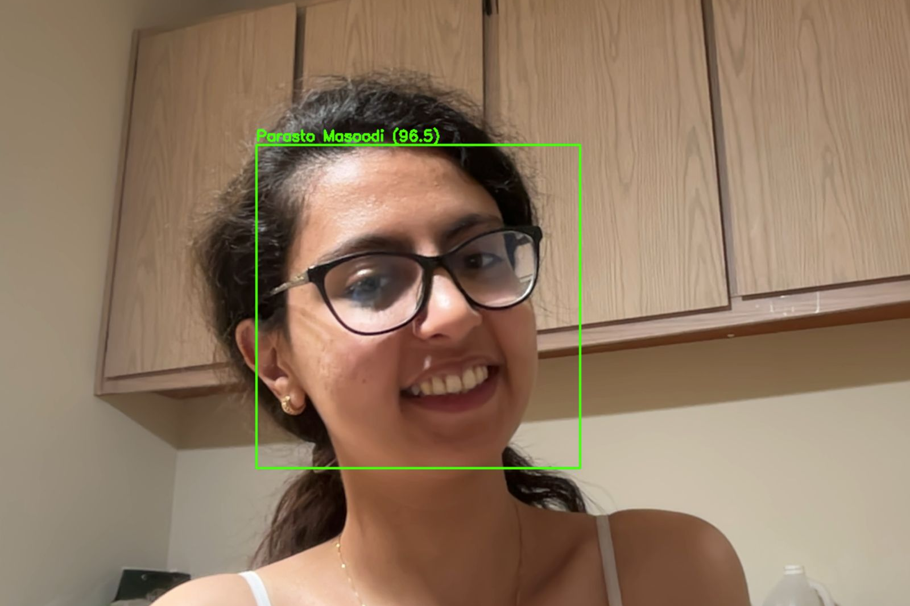
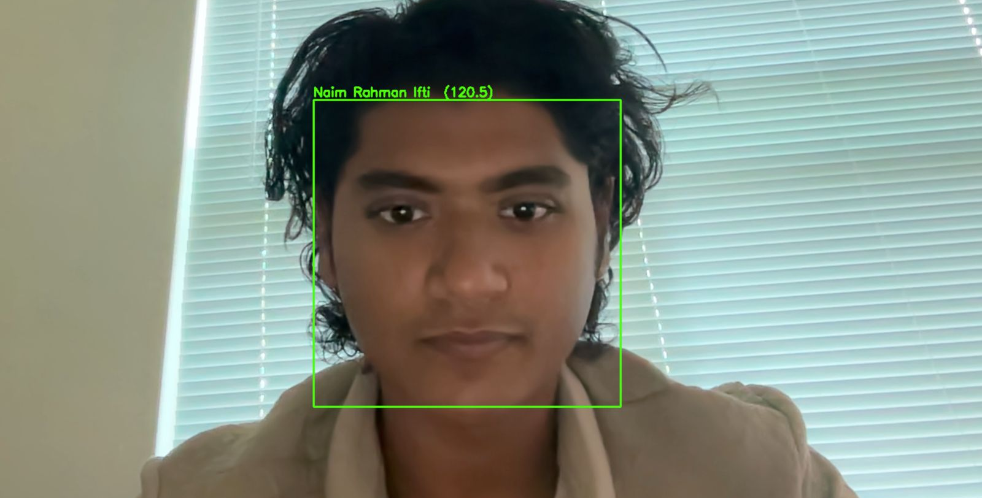
Real-Time Recognition
Capture live video using a webcam.
Detect faces in real-time.
Predict the identity.
Display the name and confidence score on the video stream.

Slide 14
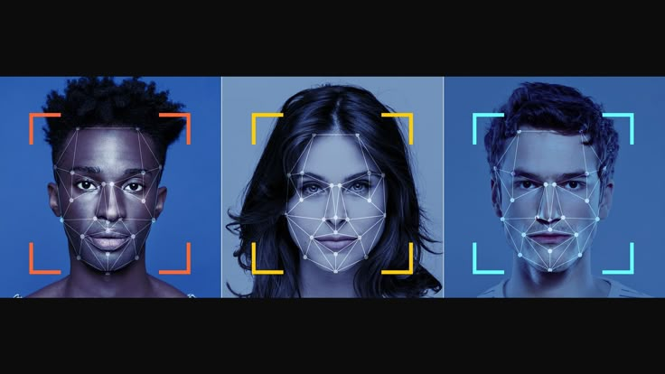
Ethical Issues and Considerations
Privacy Concerns
Bias and Fairness
False Matches and Reliability
Deepfakes

Slide 15
conclusion
Face recognition is a powerful biometric technology that continues to evolve. Using OpenCV, we explored three foundational methods—Eigenfaces (PCA), Fisherfaces (LDA), and LBPH—which are efficient, easy to implement, and suitable for real-world applications. While deep learning has advanced the field, OpenCV remains an essential toolkit for understanding and building reliable face recognition systems, especially in resource-limited environments.

Slide 16
References:
Emami, S., & Suciu, V. (2012). Facial recognition using OpenCV. Journal of Mobile, Embedded and Distributed Systems, 4(1), 33–38. Retrieved from https://www.researchgate.net/publication/267426877_Facial_Recognition_using_OpenCV
Turk, M., & Pentland, A. (1991). Eigenfaces for recognition. Journal of Cognitive Neuroscience, 3(1), 71–86. https://doi.org/10.1162/jocn.1991.3.1.71
Belhumeur, P. N., Hespanha, J. P., & Kriegman, D. J. (1997). Eigenfaces vs. Fisherfaces: Recognition using class specific linear projection. IEEE Transactions on Pattern Analysis and Machine Intelligence, 19(7), 711–720. https://doi.org/10.1109/34.598228
Ahonen, T., Hadid, A., & Pietikäinen, M. (2006). Face description with local binary patterns: Application to face recognition. IEEE Transactions on Pattern Analysis and Machine Intelligence, 28(12), 2037–2041. https://doi.org/10.1109/TPAMI.2006.244
Bradski, G., & Kaehler, A. (2008). Learning OpenCV: Computer vision with the OpenCV library. O’Reilly Media.
OpenCV.org. (n.d.). Face Recognition. Retrieved from https://docs.opencv.org/4.x/d5/dc5/tutorial_face_recognition.html

